Slide 1

AE 497-8
Seminar on Student’s Projects
Department of Agricultural and Biosystems Engineering
Lecturer: William Amponsah, PhD

Slide 2
Content
Student’s Final Project and Assessment
Student-Supervisor Working Relationship
Contents and Structure of the Dissertation
Oral Presentation (Next Seminar)

Slide 3
Student’s Final Project
Supervised research project by individual students as part of requirement for graduation
Duration: 1 year
Objective: To train students to carry out independent research projects through the application of accumulated knowledge in specialized field of study

Slide 4
Specializations
Also related to Post-Grad specializations:
Soil and Water Engineering
Food and Post-Harvest Engineering
Farm Power and Machinery Engineering
Agro-Environmental Engineering
Bio-Engineering

Slide 5
1st Semester
Formulation of project topic and research objectives
Establishing the problem and scientific justification
Literature review on important aspects of the research theme
Proposed methodology to address the problem

Slide 6
2nd Semester
Building on the proposed methodology
Actual field experiment/ lab-work/ surveys
Data collection
Data analysis
Interpretation of data
Final write-up of the dissertation

Slide 7
Assessment
1st semester
  Credit: 1 for presentation of synopsis
2nd semester
  Credit: 5 for dissertation and presentation
  30% for presentation
  70% for dissertation
  1 and 6 for presentation and dissertation (Agric. Mech.)

Slide 8
Student-Supervisor Relationship
This is your work.
Your supervisor is to guide and direct you.
You are a STUDENT not a LABOURER.
Have constructive discussions with them, not YES SIR, YES SIR attitude.
My BSc project as an example.

Slide 9
Student-Supervisor Relationship
This is the first most important step for your career human relationship.
You probably wouldn’t be going for lectures and writing exams for the rest of your life.
You will be working with people.

Slide 10
Tenant-Landlady Relationship
TENANT’S PERCEPTION | LANDLADY’S PERCEPTION
The rent is already too high | The rent has not been increased for a long time
With other costs going up, I can’t afford to pay more for housing | With other costs going up, I need more rental income
I know people who pay less for a comparable apartment | I know people who pay more for a comparable apartment
Young people like me can’t afford to pay high rents | Young people like him tend to make noise and to be hard on an apartment
The rent ought to be low because the neighborhood is rundown | We landlords should raise rents in order to improve the quality of the neighborhood

Slide 11
Tenant-Landlady Relationship
TENANT’S PERCEPTION | LANDLADY’S PERCEPTION
I am a desirable tenant with no dogs and cats | His Facebook and Insta drive me crazy
The apartment needs painting | He has given that apartment heavy wear and tear
I always pay the rent whenever she asks for it | He never pays the rent until I ask for it
She is cold and distant; she never asks me how things are | I am a considerate person who never intrudes on a tenant’s privacy

Slide 12
Contents of the Dissertation
Cover and Title-Page
Front/Signature Page
Abstract
Acknowledgements and Dedication
Table of Contents (List of Tables and Figures)
Introduction
Literature Review
Materials and Methods
Results and Discussion
Conclusions and Recommendations
References
Appendices

Slide 13
Cover and Title-Page: Example
  KWAME NKRUMAH UNIVERSITY OF SCIENCE AND TECHNOLOGY KUMASI, GHANA
  COLLEGE OF ENGINEERING
  DEPARTMENT OF AGRICULTURAL AND BIOSYSTEMS ENGINEERING
  IMPROVEMENT OF IRRIGATION TECHNIQUES FOR FARMERS IN BANKYEKROM
  NAME: KWEKU ANANSE
  INDEX NO.: 0000000
  JANUARY 1777

Slide 14
Cover and Title-Page
The title is the most important element of the cover page
The best title is this title correctly explaining the context of the dissertation in as few as possible words
Try to avoid extra words as “Study of…”, “Contribution to the study of…”.
Avoid abbreviations, chemical formulae and trade names in the tile
University logo

Slide 15
Front/Signature Page
First page of the dissertation report
Comes immediately after the cover page
Explicitly states the title of the dissertation and the purpose
It also serves as the signature page for both student and supervisor

Slide 16
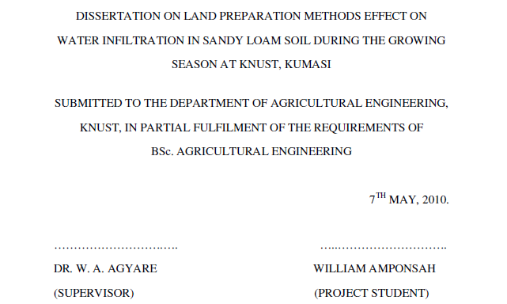
Front/Signature Page: Example

Slide 17
Abstract
Summary of the dissertation
It includes MAIN purpose, methods, results, conclusions and recommendations
It highlights the essential points of the dissertation
Keep the abstract not more than one page
The abstract also adds no new information but simply summarizes the dissertation
Presentations should highlight the contents of the abstract

Slide 18
Acknowledgements and Dedication
Can appear on different pages
This is the only non-scientific part of the thesis
A simple and courteous relation made between the student and all persons having helped in one or another way
It gives evidence of courtesy to thank somebody (your supervisor, parents, technicians, mates) who helped you with your studies, with any material or with an important idea or interpretation
Write correctly the name, title and function and take care of the order of importance
Dedication means DEDICATION

Slide 19
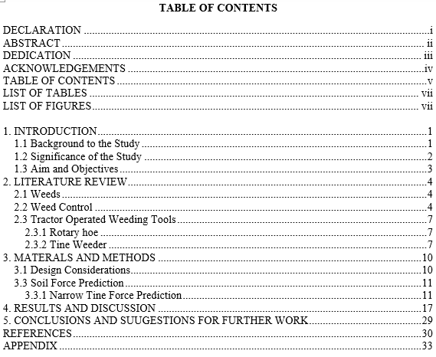
Table of Contents

Slide 20
List of Tables and Figures
Figures include pictures, graphs and charts
The list should include the table or figure number, the exact title and the page where it is found
Tables and figures should stand on their own without reference to the text but they need to be referred to in the text
HOW TO DO THIS AUTHOMATICALLY IN MICROSOFT WORD! (Any idea?)

Slide 21

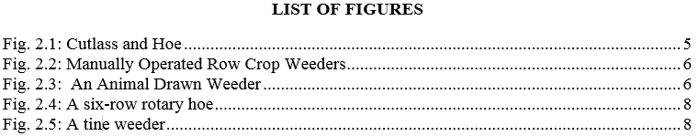
List of Tables and Figures

Slide 22
Introduction
Answer to ‘WHAT IS THE PROBLEM?’
Tell readers what you plan to tell them.
Enough background information should be given in order to let the reader understand and evaluate the results without consulting other papers before.
The aim and possible limitations of the proposed study are given.
You would BETTER write it after having written the main part.

Slide 23
Introduction
FORMAT:
Background to the study
  Must include the ‘problem statement’
Significance of the study
  How is the study going to solve the problem (scientifically!)?
Aim and objectives
  Main aim/objective (reference to the title)
  Specific objectives (what you would do to achieve the main objective – measurable)
  Use terms like (TO) DETERMINE, EVALUATE, DESIGN etc
Do not show figures, tables and bulleted/ numbered points in the introduction (except specific objectives)

Slide 24
Introduction
SOME RULES:
First explain the nature of the problem.
For orientation, the most important references can be shortly cited.
Mention the used methods and materials.
A lay-out must be given as well as the general connection between the different parts.
An abbreviation can be put immediately after the word between brackets when it is used for the first time.

Slide 25
Literature Review
A summary of the different aspects of the subject, as it was found in the literature.
A critical discussion of important related research.
Work others have done in relation to your area of study.
Identify PROGRESS and LIMITATIONS in the area of study.
REFERENCES! Don’t copy and paste.
PLAGIARISM is an academic crime, corruption!

Slide 26
Materials and Methods
Answer to ‘HOW DID YOU STUDY THE PROBLEM?’
The used methods and materials are discussed in detail.
With this information, it should be possible for the reader to repeat the experiment/study.
Technical details are often necessary, mention also the sources (references)

Slide 27
Materials and Methods
If this chapter is subdivided, use the same order in the ‘Results and Discussion’
When the used methods are new, all details must be given
If the used methods are described in standard books, mention only the reference

Slide 28
Results and Discussion
Answer to ‘WHAT DID YOU FIND AND WHAT DOES IT MEAN?’
The experiments are briefly arranged and the results are given and discussed
If an experiment leads to results, TABLES and FIGURES are used
Also, ‘negative’ results can be given
Clearly separate main findings from secondary findings

Slide 29
Results and Discussion
Avoid ‘luxuriousness’ in the presentation by repeating the results in tables, figures and the text
Make reference as straight as possible
  ‘Out of Table 1 it is clear that decreasing the temperature enhanced the number of dead plants’
  Decreasing the temperature enhanced the number of dead plants (Table 1)
In the discussion, a relation needs to be made between most of the observed results

Slide 30
Results and Discussion
Keep the following points in mind:
Demonstrate in the results the principles, relations and general trends
Do not repeat the results, but discuss them
Points out the exceptions, the absence or lack of correlation
Demonstrate the accordance or discordance between the obtained results and earlier published work
Conclude as clearly as possible

Slide 31
Results and Discussion
  Objective: To reconstruct peak discharges through hydrological modelling.

Slide 32
Tables and Figures
Give each figure and table a number and title.
Refer to each figure and table in the text of the dissertation.
First reference in the text should be on the same page or close to the table/figure
The title of a table goes above the table, while the title of a figure goes below the figure.

Slide 33
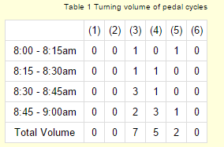
Tables: Example
Table 1: Number of phones stolen from 8:00 to 9:00 am

Slide 34
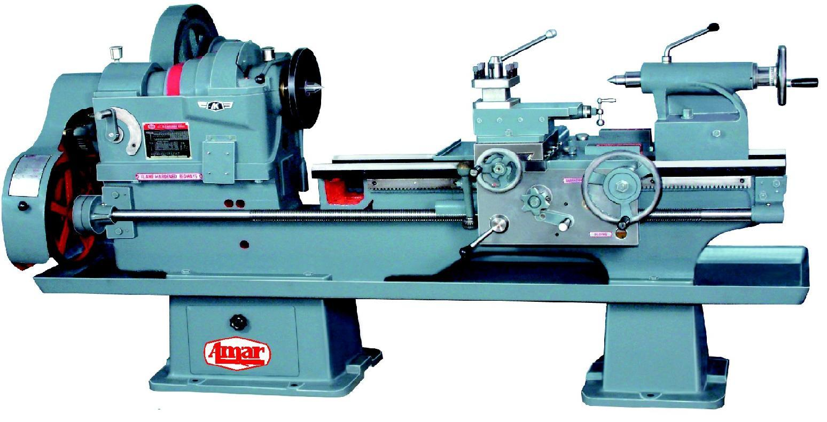
Figures: Example
Figure 1: Centre lathe

Slide 35
Conclusions and Recommendations
The most important results and how they were obtained are repeated
In the introduction the aim of the work is explained
In the conclusion it is shown to which degree the aim has been attained
Do not give any conclusions to things which have not been discussed
Provide recommendations based on important findings and way forward to improve the study

Slide 36
References
In-text references and Reference list
Use the Harvard Referencing Style
References serve as a guide to any reader who wants to refer to previous work on the subject.
It is also meant to show appreciation for the invaluable work of other researchers.
Failure to credit the work of others is regarded as:
  Carelessness on the part of the author
  Lack of courtesy and even more seriously
  Plagiarism, in which case the student would be failed

Slide 37
Harvard Referencing Style
In-text reference should simply have the surname of the author and the year of publication
  (Amponsah, 2018)
If there are two authors, both surnames are given before the year
  (Kemausuor and Akowuah, 2018)
If there are more than two authors, the surname of the first author is given, followed by “et al” in italics and then the year
  (Agyare et al., 2018)
If one author has published more than one cited document in the same year, these are distinguished by adding lower case letters after the year.
  (Kyei-Baffour, 2018a)

Slide 38
Harvard Referencing Style
Examples: in-text references
“According to Agodzo (2003a) it is indicated …”
……………….. (Aikins, 2015)
“Equations developed by Bart-Plange et al. (2002) can be used to …”
“Kyei-Baffour (2004) outlines the principle for the design of simulators…”

Slide 39
Harvard Referencing Style
List of References
Journal: Bart-Plange, A. and Baryeh, E. A. (2003). The physical properties of Category B cocoa beans. Journal of Food Engineering. 20(1): 219-227
Book: Morgan, R. P. C. (1986). Soil erosion and conservation. Longman, U.K.
Contribution to a book: Kyei-Baffour, N., Bobobee, E. Y. H. and Koram, S. A. (1994). The effects of tillage and irrigation practices on soils in Ghana: A case study. In: L. O. Fresco, L. Stroosnijder, J. Bouma and H. van Keulen, eds. The future of the land. Willey, Sussex. 363-364
Technical Report: Agodzo, S. K., Huibers, F. P., Chenini, F., van Lier, J. B. and Duran, A. (2003). Use of wastewater in irrigated agriculture. Country studies from Bolivia, Ghana and Tunisia. Volume 2: Ghana. Wageningen WUR (WF4-Wastewater)-ISBN 90-6754-704-2

Slide 40
Harvard Referencing Style
Examples: List of References
Agco Allis (2011). Tractor, Service and Operator’s Manuals. Electronic document. Retrieved from: http://www.tractormanual.info/. Accessed on 3 May 2011.
Bhutta, M.S., Tanveer, T. and Awan, H.M. (1997). Technical Skill of Tractor Operator: A Case Study in Multan, Pakistan. Agricultural Mechanisation in Asia, Africa and Latin America, 28 (1): 18–22.
Davies, D.B., Eagle, D.J. and Finney, J.B. (1993). Soil Management, Ipswich, Farming Press.
MINITAB Inc. (2007). MINITAB Statistical Software Release 15 for Windows. Pennsylvania, Minitab Inc., State College.

Slide 41
Appendices
Copies of your questionnaire
Any additional Maps
Formulae/ Tables/ Charts that are relevant to the work
Additional designs that were not included in the text
Any other relevant information, letters

